Slide 1
Relational Algebra (Part-7)
20.6

Slide 2
Contents
Set Difference

Slide 3
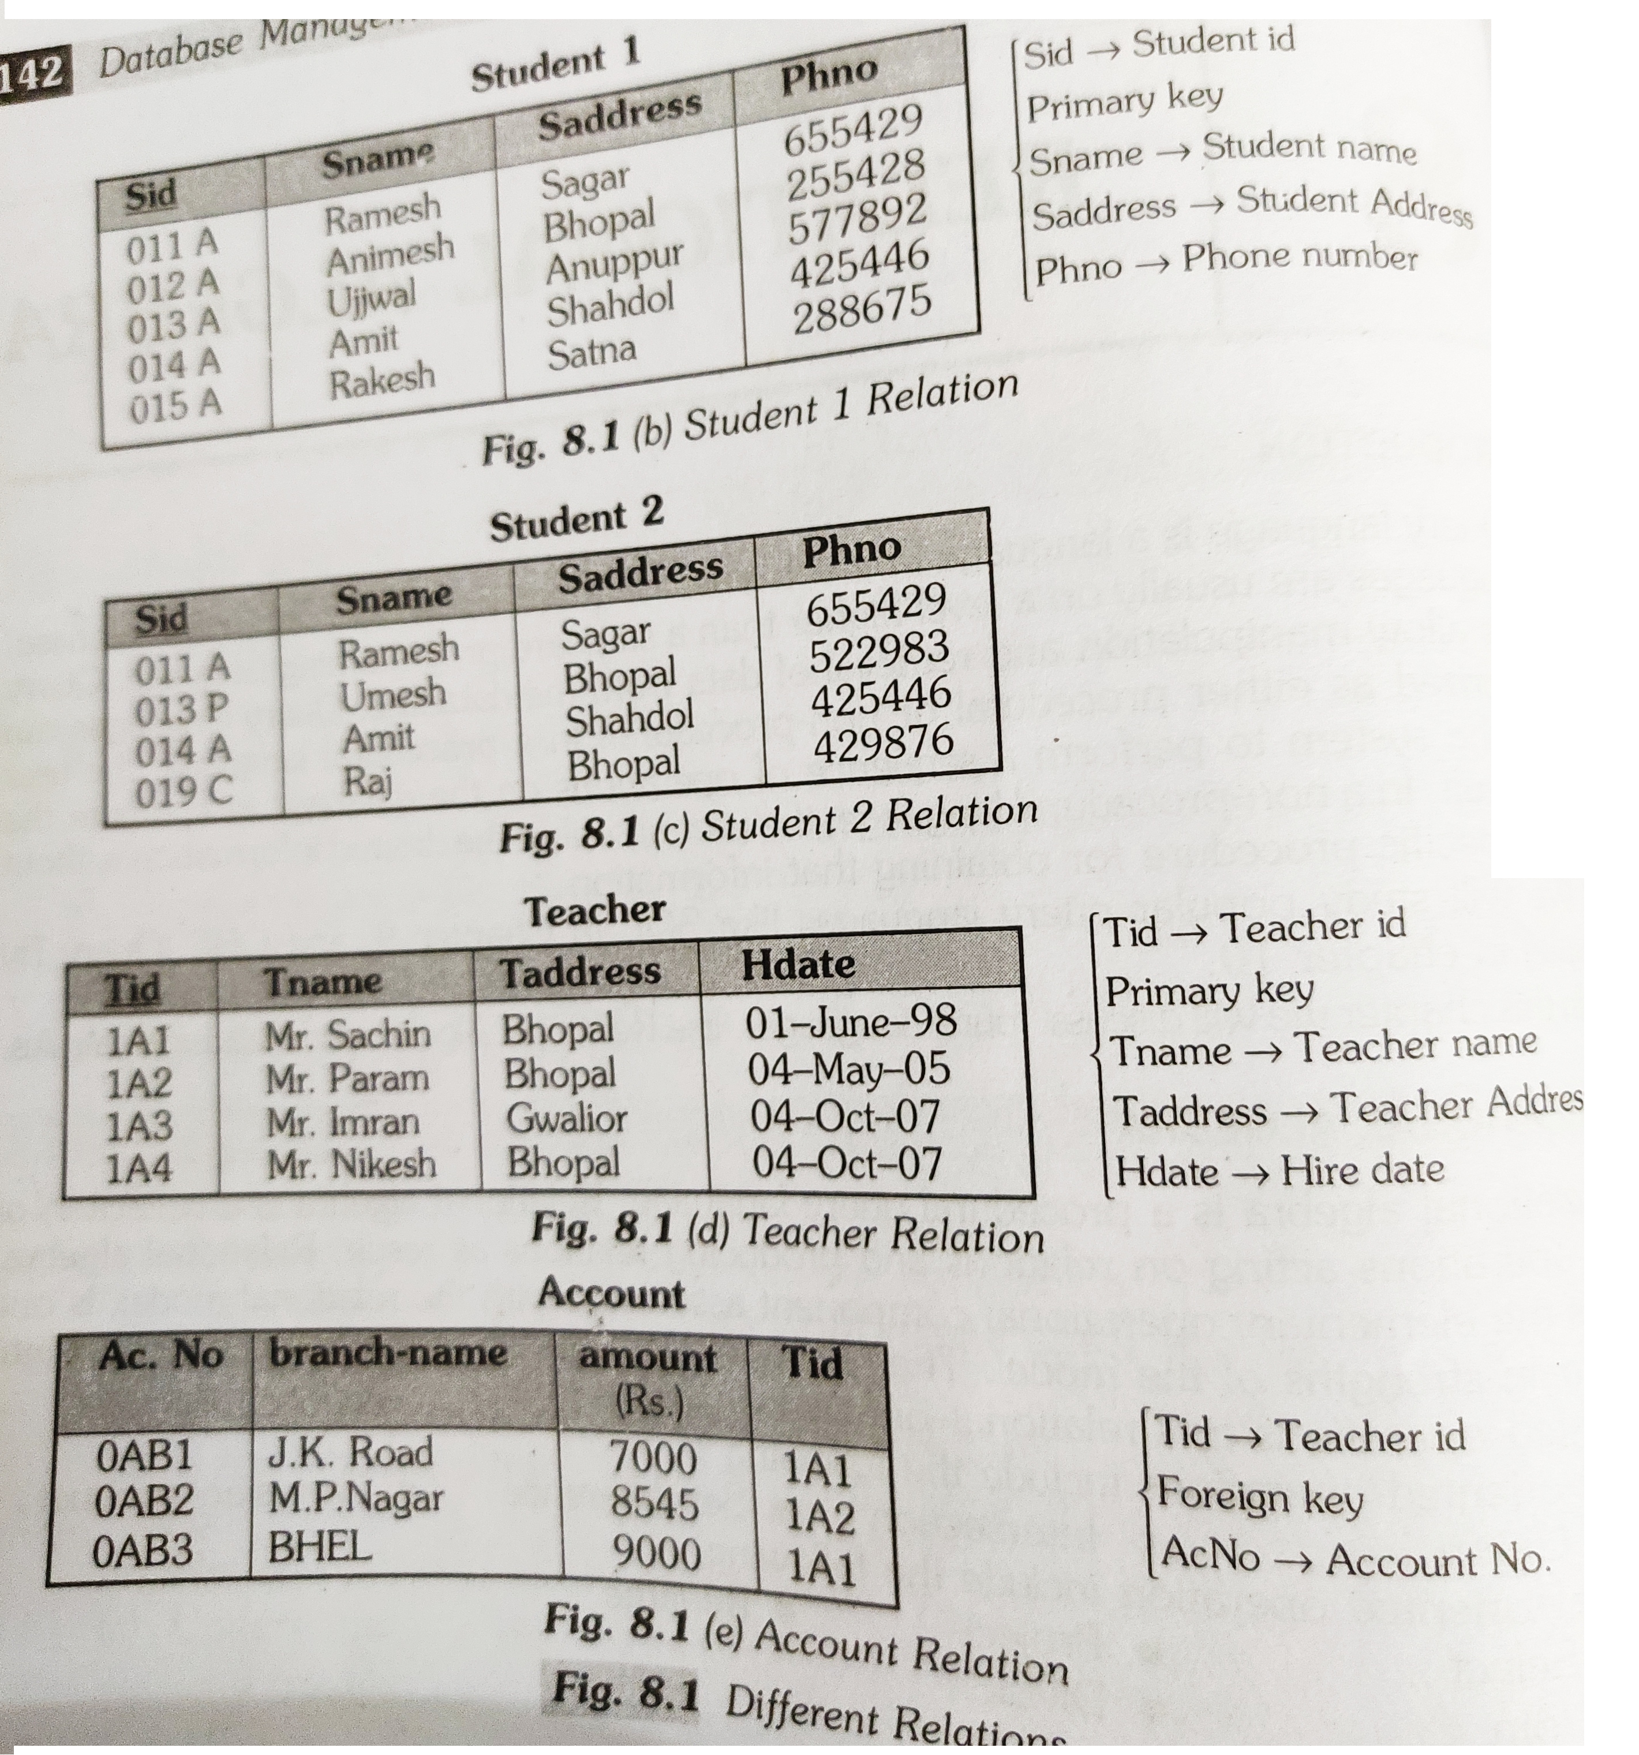
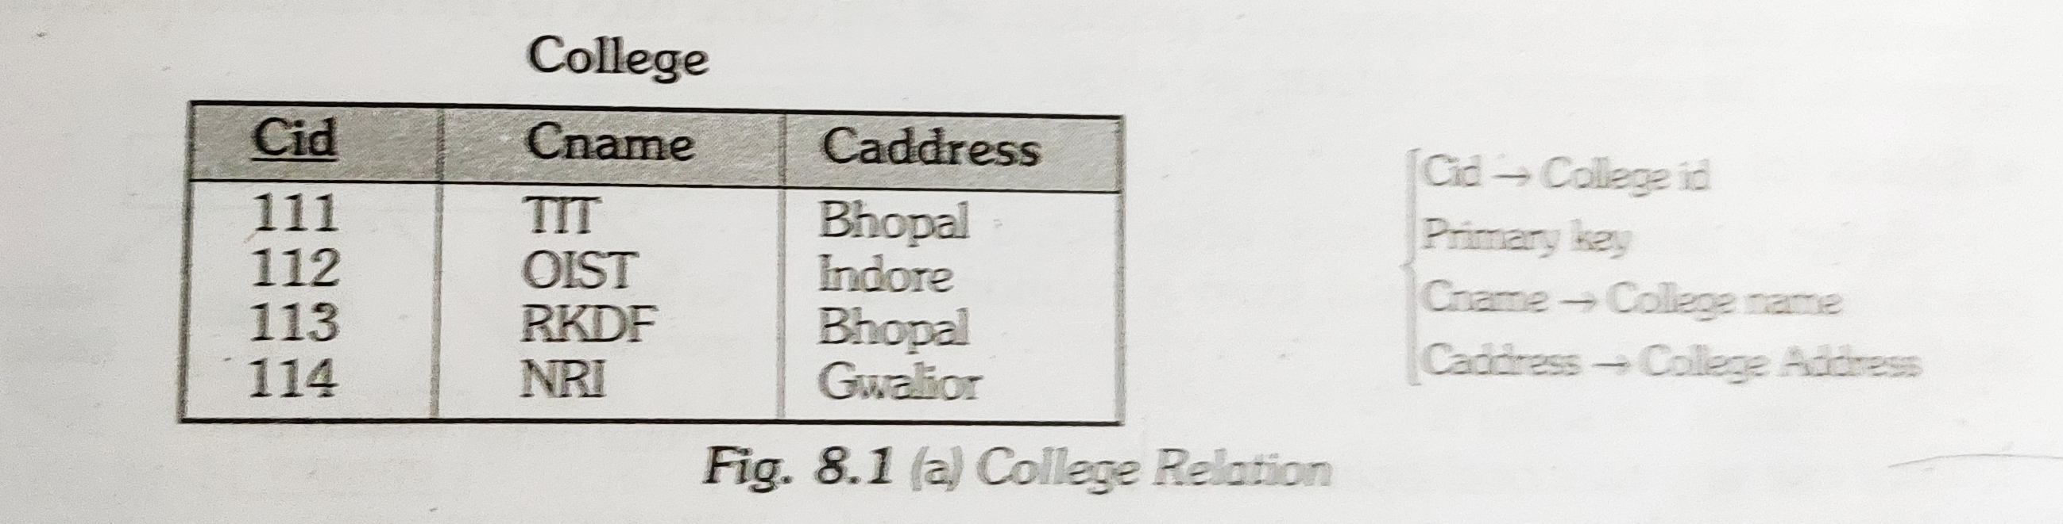
Set Difference

Slide 4
Set Difference
The result of A - B, is a relation which includes all tuples that are in A but not in B.
The attribute name of A has to match with the attribute name in B.
The two-operand relations A and B should be either compatible or Union compatible.
It should be defined relation consisting of the tuples that are in relation A, but not in B.

Slide 5
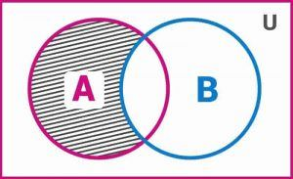
Set Difference
A – B: This is read as A difference B. Sometimes, it also referred to as ‘relative complement’. This represents elements of set A which are not there in set B

Slide 6
Set Difference

Slide 7


